Slide 1
One-shot Learning
CDT Wesley Swain

Slide 2
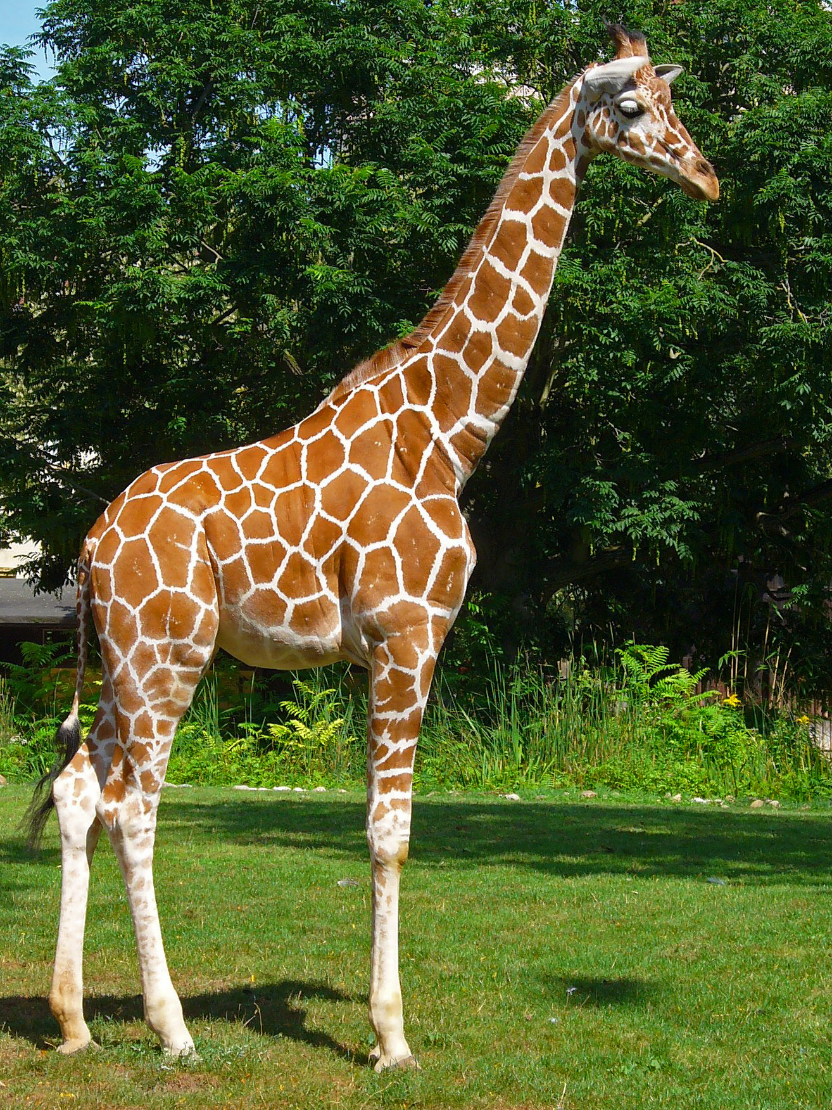
The Generalization Gap
Special models beat human performance at specific tasks
BUT… those models require a superhuman amount of data
Humans outperform algorithms in generalization
Examples: giraffes, spatulas
This Photo by Unknown Author is licensed under CC BY-SA

Slide 3
Few-shot Learning
How to train models to differentiate classes with minor support sets
N-way, k-shot learning:
N classes to differentiate
k examples of each class to train on
One-shot learning

Slide 4
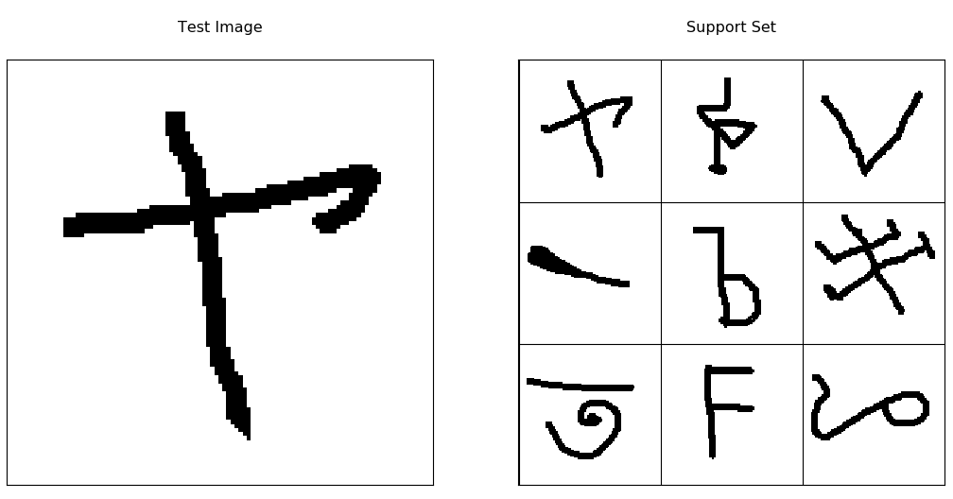
Datasets
Omniglot (Lake, et al)
50 alphabets
1623 total characters (classes)
20 attempts per character
miniImageNet (Vinyals, et al)
100 classes (64 train, 16 val, 20 test)
600 images per class
84x84, RGB
dogsImageNet

Slide 5
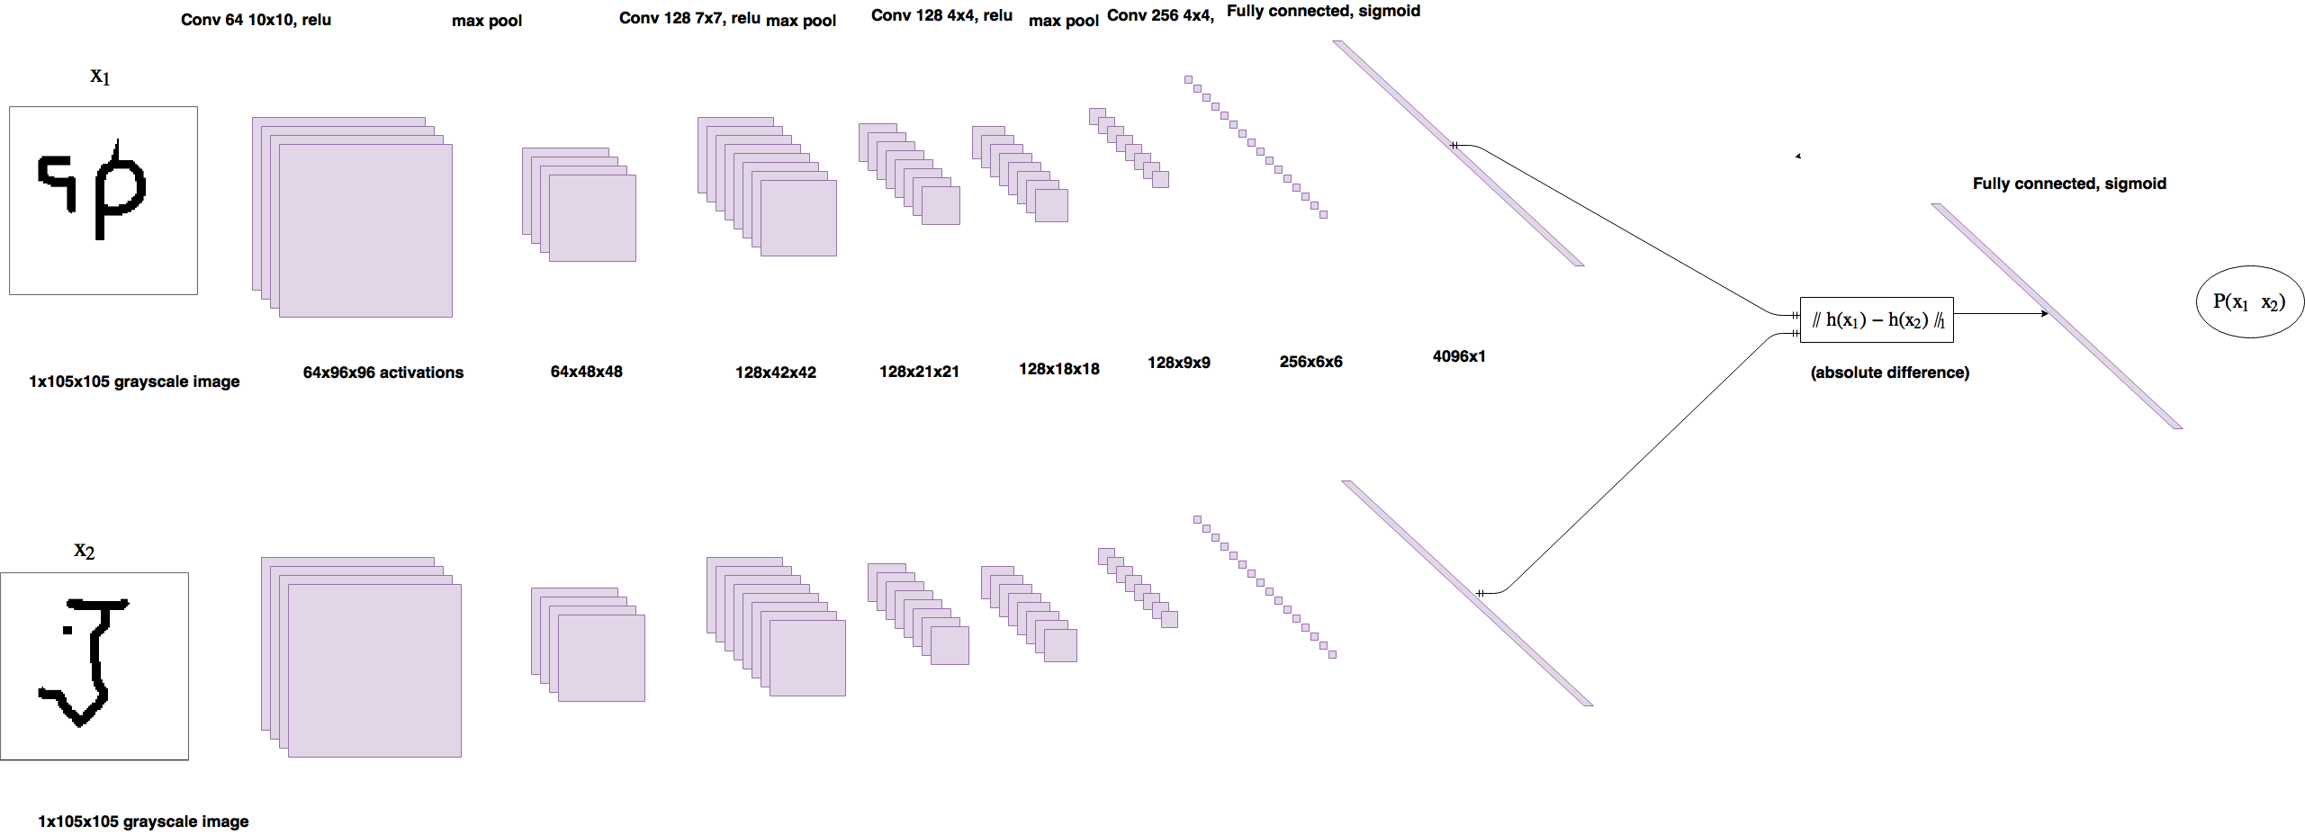
keras-oneshot
Siamese networks for few-shot learning (Koch, et al)
Siamese Networks: (PC: Soren Bouma, see refs)

Slide 6
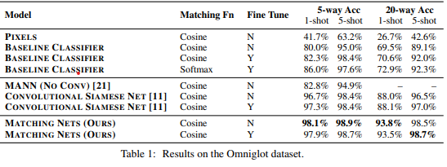
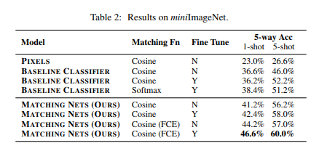
Data from Vinyals, et al (2016)

Slide 7
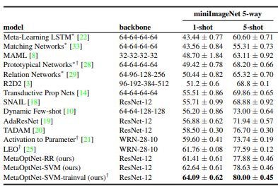
Implemented Version: Lee, et al (2019)
Notes:
See Papers With Code for more…

Slide 8
References
Bouma, S. 2019, keras-oneshot, GitHub, https://github.com/sorenbouma/keras-oneshot.
Bouma, S. 2017, "One Shot Learning and Siamese Networks in Keras," Soren Bouma [Blog Post], https://sorenbouma.github.io/blog/oneshot/.
Koch, G., Zemel, R., and Salakhutdinov, R. 2015, "Siamese Neural Networks for One-Shot Image Recognition," JMLR: W&CP Vol. 37 [Academic Publication], https://www.cs.cmu.edu/~rsalakhu/papers/oneshot1.pdf.
Lake, B. 2019, omniglot, GitHub, https://github.com/brendenlake/omniglot.
Lake, B., Salakhutdinov, R., and Tenenbaum, J. 2015, "Human-level concept learning through probabilistic program induction," Science, 350(6266), 1332-1338.
Vinyals, et al. 2016, “Matching Networks for One Shot Learning,” NIPS [Academic Publication], http://papers.nips.cc/paper/6385-matching-networks-for-one-shot-learning.pdf.

Slide 9
Demonstration!
(Questions?)

